Slide 1
Frameworks

Slide 2


TODAY’S TOPICS
DIFFERENT TYPES OF AUTOMATION FRAMEWORKS

Slide 3
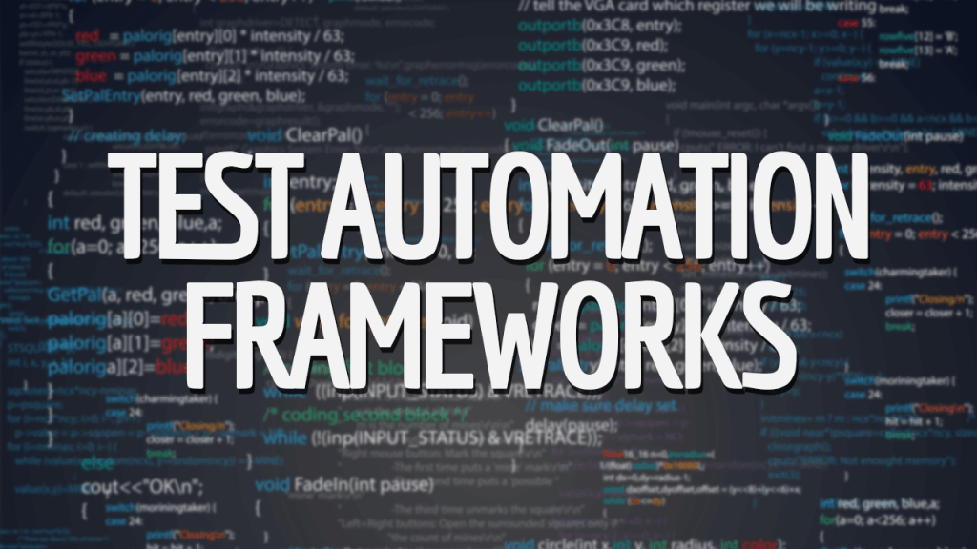

Slide 4

What is a framework
A framework defines a set of rules or best practices which we can follow in a systematic way to achieve the desired results.
test automation frameworks deal with best practices to achieve the goals of our automation project.

Slide 5
Why are we using frameworks
Framework is a code structure that helps to make code maintenance easy.
Without frameworks, we will place the “code” as well as “data” in the same place which is neither re-usable nor readable.

Slide 6
Using Frameworks, produce beneficial outcomes like
Reusability – due to modularity of test cases and library functions
Maintainability – significantly reduces the test maintenance effort
higher code readability
Manageability - effective test design, execution, and traceability
Accessibility – to design, develop & modify tests whilst executing
Availability – scheduled execution can run unattended on a 24/7 basis
Reliability – due to advanced error handling and scenario recovery
Flexibility – framework independent of system or environment under test
Measurability – customisable reporting of test results ensure quality..

Slide 7


You may have the BEST tool, but if you are not using it right you will not benefit very well
Gurhan – 2018
™

Slide 8
Some popular frameworks
Data Driven Testing Framework.
Keyword Driven Testing Framework.
Hybrid Testing Framework.
Test driven development framework
Behavior Driven Development Framework

Slide 9

Data driven framework
Driven by data!
Data Driven framework is focused on separating the test scripts logic and the test data from each other
Allows us to create test automation by passing different sets of test data
The test data set is kept in external files or resources such as MS Excel Sheets, MS Access Tables, SQL Database, XML files etc.

Slide 10
Why data driven framework?
Usually you have your data in excel sheets
Assume you need to run a set of tests with different data (Say, login test)
If we run the same test with multiple test data sets manually it is time-consuming, and error-prone.

Slide 11
Assume, you need to test login form with 50 different sets of test data
As a manual tester, you do log in with all the 50 different sets of test data for 50 times
As an automation tester, you create a test script and run 50 times by changing the test data on each run or you create 50 test scripts to execute the scenario
We can achieve Data-driven framework using TestNG's data provider

Slide 12
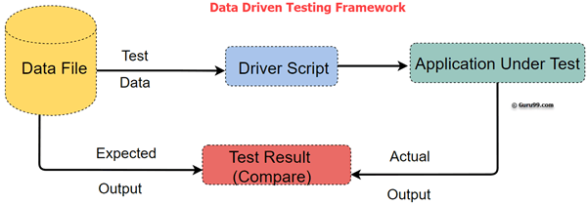
Tl;dr ==> we adopt Data Driven Framework when we have to execute the same test with multiple sets of test data.

Slide 13
Hybrid testing framework
Hybrid Test framework is a concept where we are using the advantage of both Keyword and Data driven framework
Hybrid testing is what most frameworks evolve/develop into over time and multiple projects.
Basically this is using some of the advantages of the both framework we just mentioned
More info ⬅

Slide 14
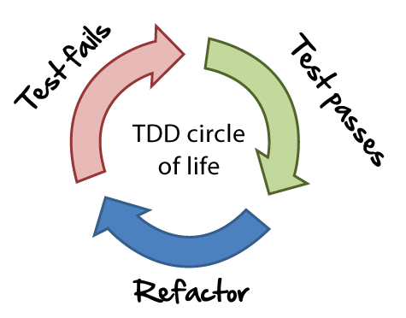
Test driven development
Write UNIT tests before writing functionalities
Run the tests ➔ Tests will fail
Write the minimum amount of code required to make the test pass
Run the tests again ➔ tests will pass
Optionally refactor your code
Repeat from 1

Slide 15
Behavior driven development
Behavior Driven testing is an extension of TDD
Like in TDD in BDD also we write tests first and then add application code
The major difference that we get to see here are
Tests are written in a language that is very similar to English (gherkin)
tests are explained as behavior of application and are more user focused
The whole team comes together to discuss, create, and understand feature files.

Slide 16
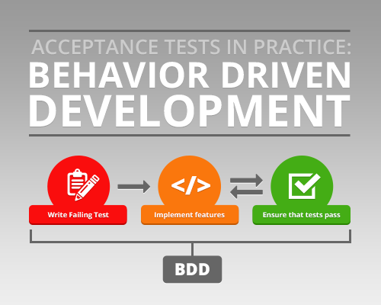

Slide 17
Why bother for bdd when you can do tdd?
Shifting from thinking in “tests” to thinking in “behavior”
Strong Collaboration between Business stakeholders, Business Analysts, QA Team and developers
Extends Test Driven Development (TDD) by utilizing natural language that non technical stakeholders can understand
More info ⬅

Slide 18


What tool do you use?

Slide 19
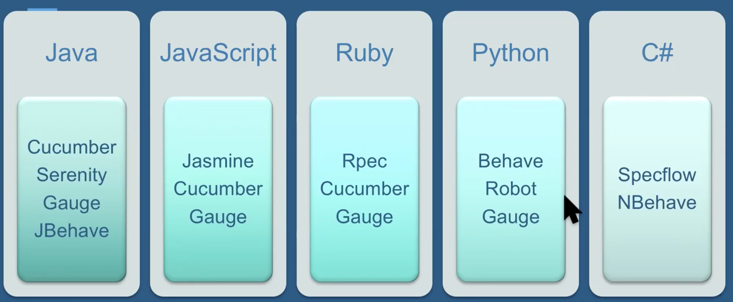
Options to choose from for bdd

Slide 20

Questions related
Which framework you are currently using? And why?
what are some of the advantages of the framework you are using?

Slide 21
Next mentoring topics?
Go over the real work framework
Anything requested?

Slide 22

Questions?

Slide 23
